Slide 1
Equivalence of Two Finite Automata

Slide 2
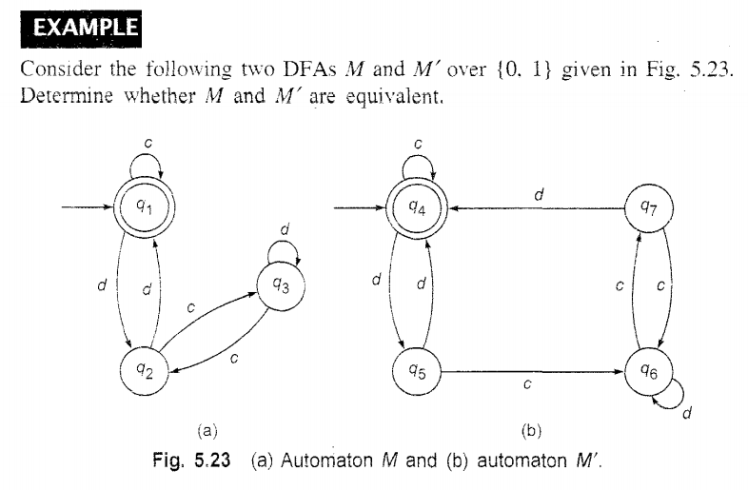
Equivalence of Two Finite Automata

Slide 3
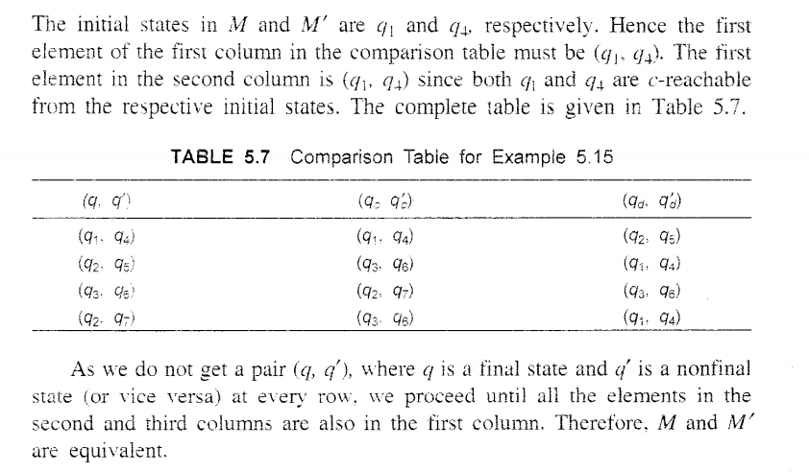
Equivalence of Two Finite Automata

Slide 4
Equivalence of Two Finite Automata

Slide 5
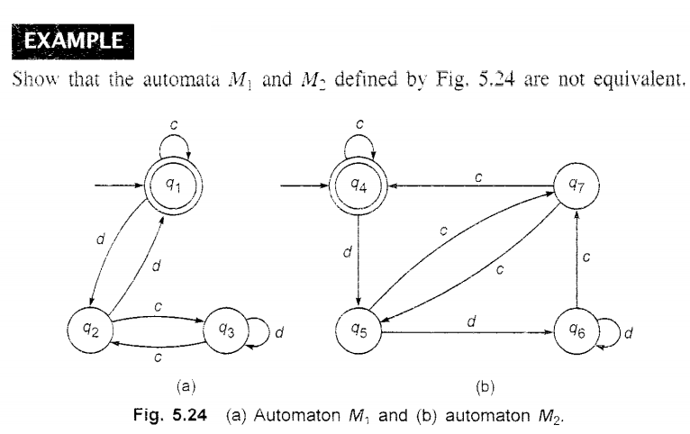
Equivalence of Two Finite Automata

Slide 6
Pumping Lemma of Regular Sets (Or Regular Languages)
The result is called pumping lemma as it gives a method of pumping (generating) many input strings from a given string.
As pumping lemma gives a necessary condition, it can be used to show that certain sets are not regular.

Slide 7
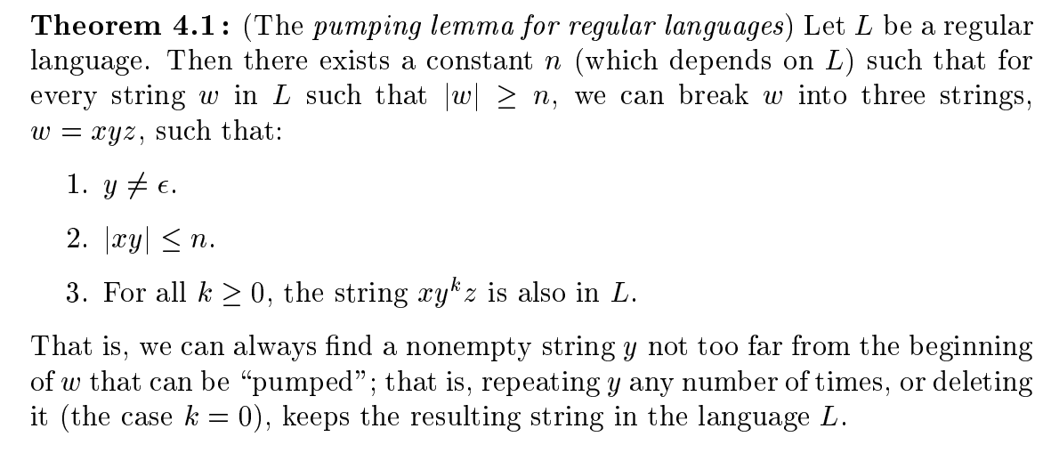
Pumping Lemma of Regular Sets (Or Regular Languages)

Slide 8
Pumping Lemma of Regular Sets (Or Regular Languages)

Slide 9
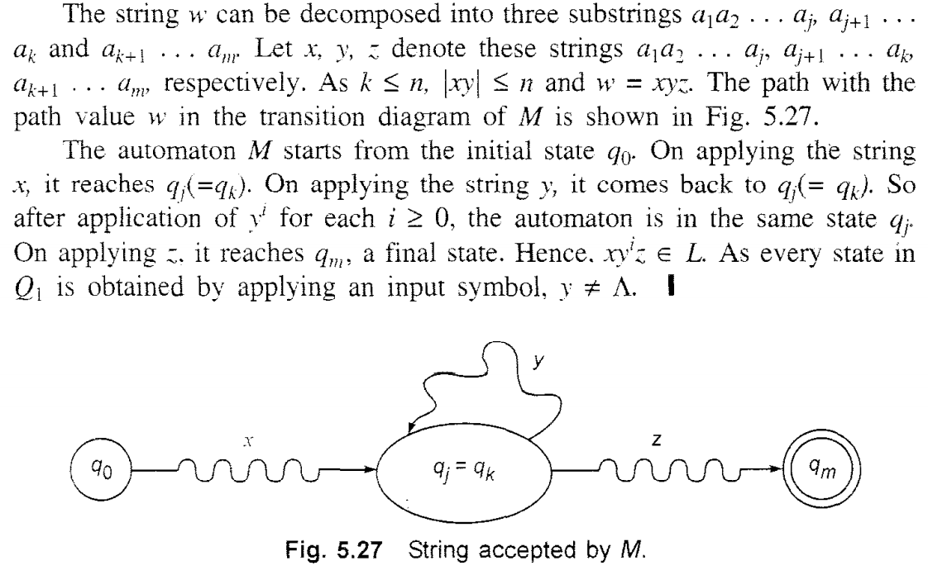
Pumping Lemma of Regular Sets (Or Regular Languages)

